Slide 1
SCIENTIFIC
PRESENTATIONS
Jennifer Botha

Slide 2
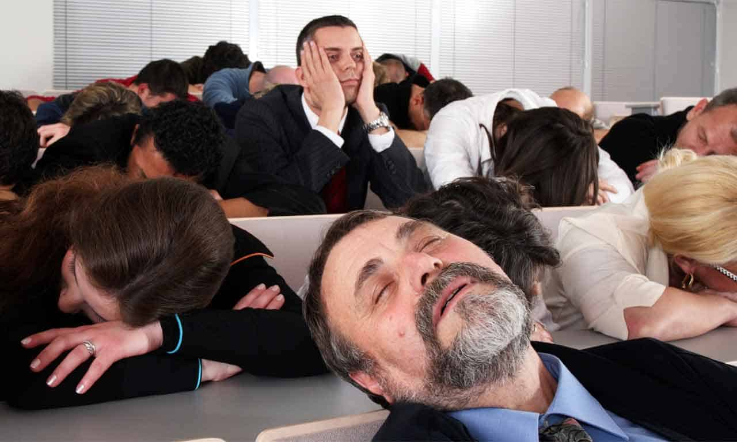
What you don’t want

Slide 3
An Essay by Jennifer Botha
You can write as clearly as you like, but an essay or block of text hits an audience like a bus (Botha, 2023). Writing complete sentences takes up too much space, when you can generally get by with writing points that will still be understood.
If the essay includes full sentences, a full on block of text and no visual aids, you are going to lose the audience. When you flip to this slide you will hear some people actually gasp.
Is the volume of text more important to read or is it more important to listen to what you are saying – or shock horror, what if both are important?! This will actually stress certain individuals out, particularly students who may actually be trying to learn something from your talk and will be taking notes.
I’ve had this experience at conferences – before there were cameras on cell phones – yes there was such a time - so yes….total nightmare. You write down half the text and then the speaker generally changes the slide half way through this essay anyway and does not get through it all.
Unless the speaker reads this essay word for word, then you have a chance if you are a really quick writer. These days you can take a picture, but at large international conferences, if you are sitting at the back…..forget…….

Slide 4
Text too small
Large text
Too much text that just repeats what you are saying makes it impossible for the audience to take in what you are saying and what they are trying to read
Do not avoid eye contact, speak loudly and clearly, don’t speak too fast, take short pauses to remind yourself to slow down
Use colour, but not too much where the slide will become too busy, particularly in graphs. Be careful of using images as a background, it makes the text difficult to see, fine for the title slide
Try stick to images and graphs as much as possible – to illustrate your data
Bullet points
Talk, loudly, clearly & slowly
Colour, not too much

Slide 5
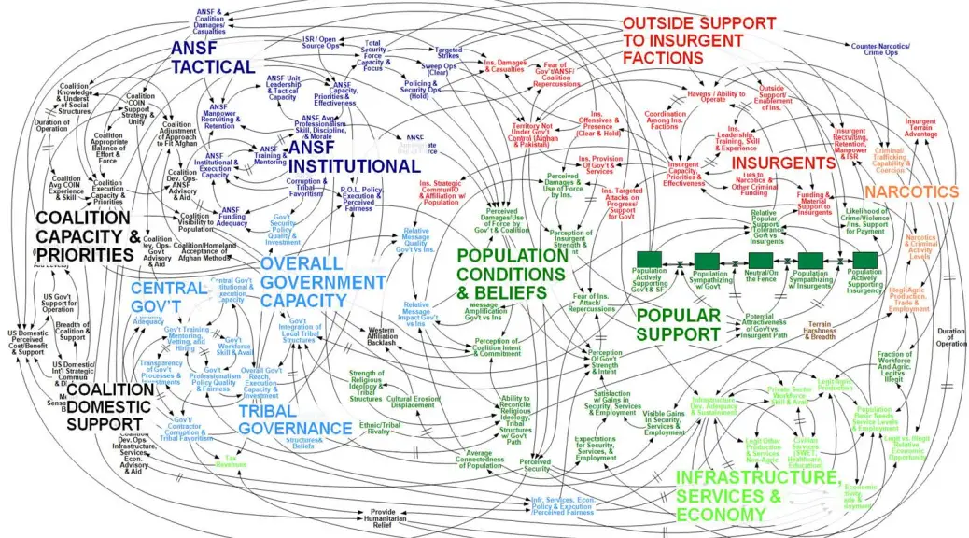
Too much information

Slide 6
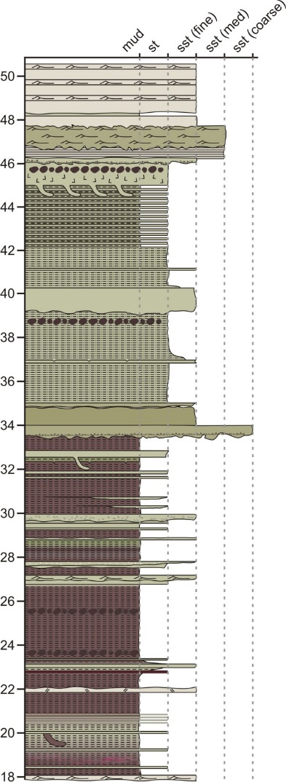
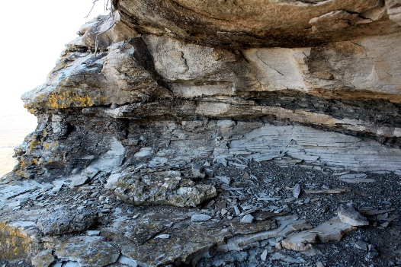
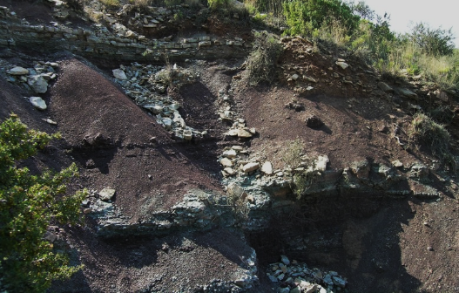
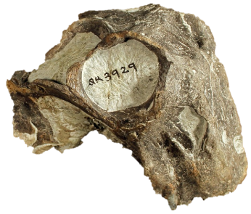
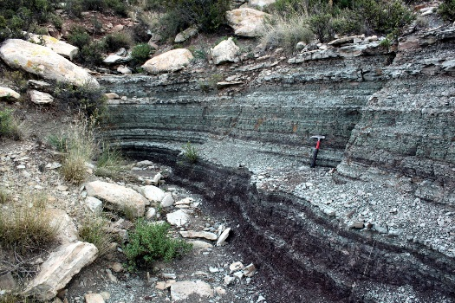
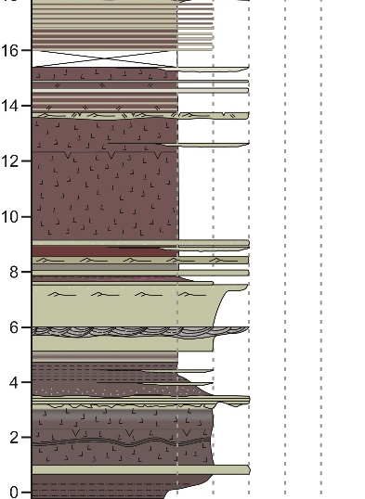
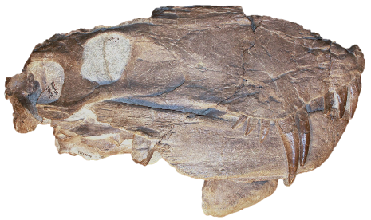
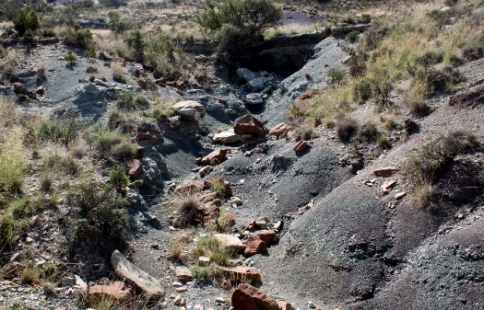
Identification of Karoo PTB
LAD of typical Permian fauna +
FAD of typical Triassic fauna +
Mudstone-siltstone couplets +
Transition from Glossopteris-dominated to Dicroidium-dominated flora +
Negative δ¹³C excursion at or just below PTB
δ¹³C
PTB
251.7Ma

Slide 7
Use colour, Be organised

Slide 8
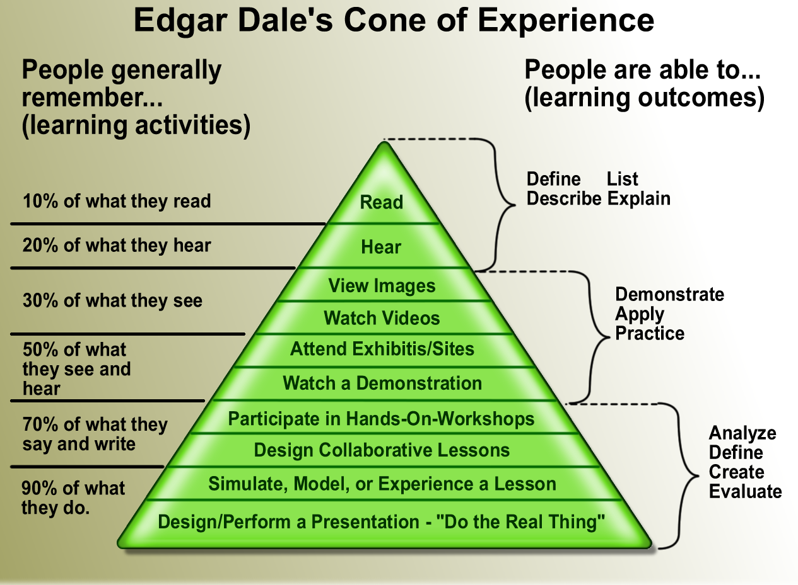
Pictures speak a thousand words

Slide 9
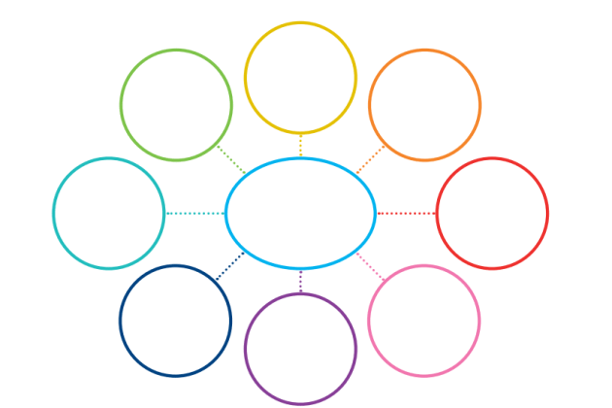
Introduction
Methods
1.
2.
3.
Acknowledge
Results
1.
2.
3.
Broader
meaning?
MIND MAP
Interpretation
Explanation
Discussion
1. Findings
ORGANISE

Slide 10
Overview
You may want to provide a road map of your presentation
NOT if you do not have time!
Introduction
Methods & Results
Discussion

Slide 11
Introduction
Capture the audience
Outline the problem/question
How are you going to answer the question, i.e. What are the aims/objectives of your research?
Why is it important?

Slide 12
Background
You can write as clearly as you like, but an essay or block of text hits an audience like a bus (Botha, 2023). Writing complete sentences takes up too much space, when you can generally get by with writing points that will still be understood.
If the essay includes full sentences, a full on block of text and no visual aids, you are going to lose the audience. When you flip to this slide you will hear some people actually gasp.
Is the volume of text more important to read or is it more important to listen to what you are saying – or shock horror, what if both are important?! This will actually stress certain individuals out, particularly students who may actually be trying to learn something from your talk and will be taking notes.
I’ve had this experience at conferences – before there were cameras on cell phones – yes there was such a time - so yes….total nightmare. You write down half the text and then the speaker generally changes the slide half way through this essay anyway and does not get through it all.
Unless the speaker reads this essay word for word, then you have a chance if you are a really quick writer. These days you can take a picture, but at large international conferences, if you are sitting at the back…..forget…….

Slide 14
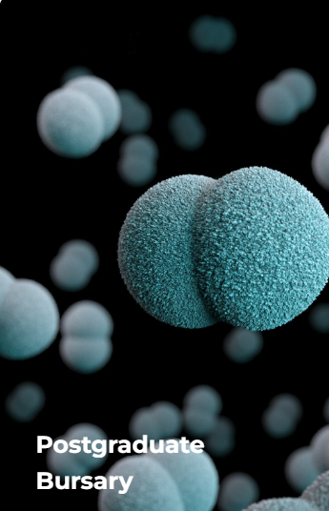
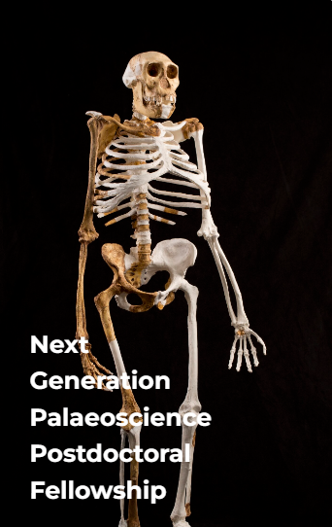
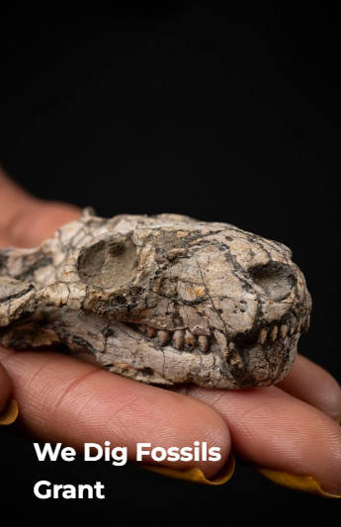
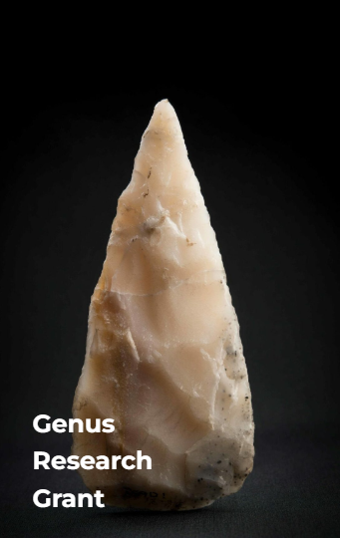
Apply for a grant and take your research to a whole new level
Applications for 2024
Honours 24 November
MSc & PhD 30 July
Postdocs & Researchers 31 October
www.genus.africa/get-funding

Slide 15
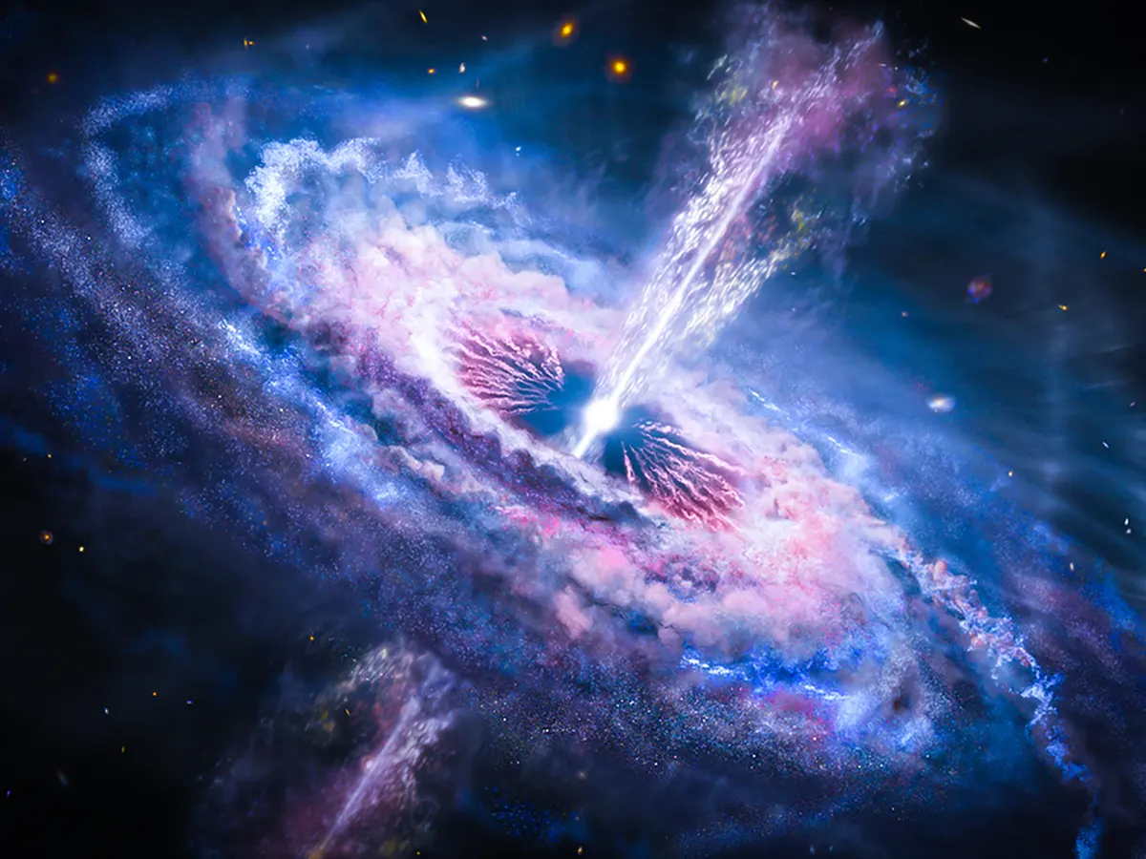
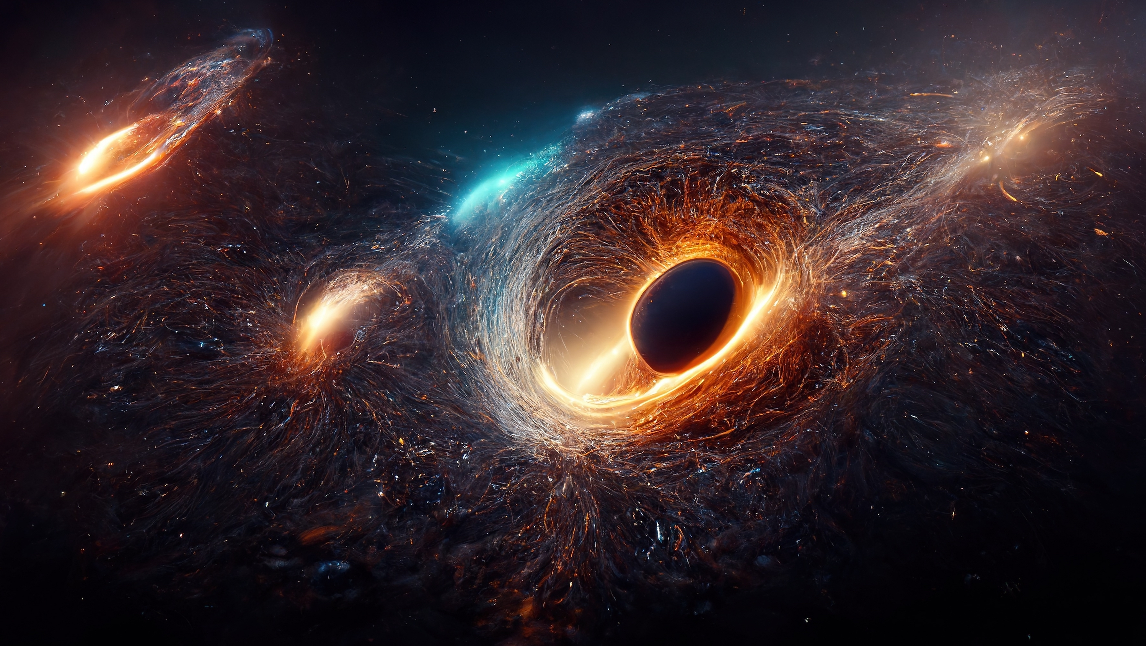
Introduction
Capture the audience
Outline the problem/question
How are you going to answer the question, i.e. What are the aims/objectives of your research?
Why is it important?

Slide 16
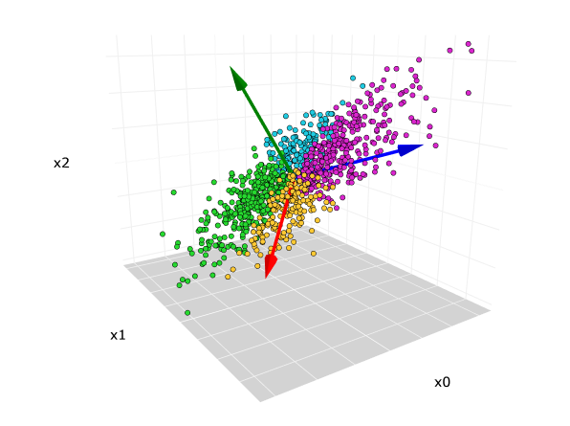
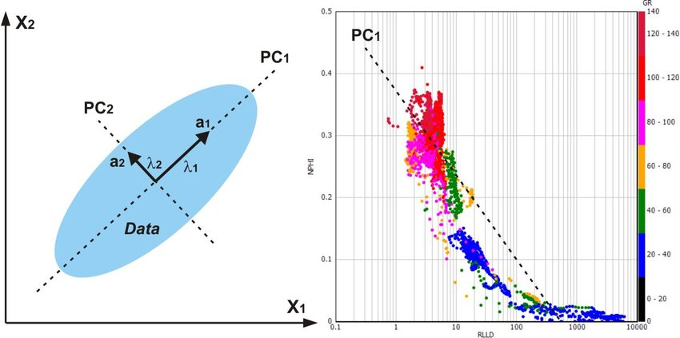
Methods
Principal Components Analysis
Method of extracting important features from a large dataset
Why use PCA?
Clear & simple
Note each method used & why
Simplify complicated methods
Explain methods

Slide 17
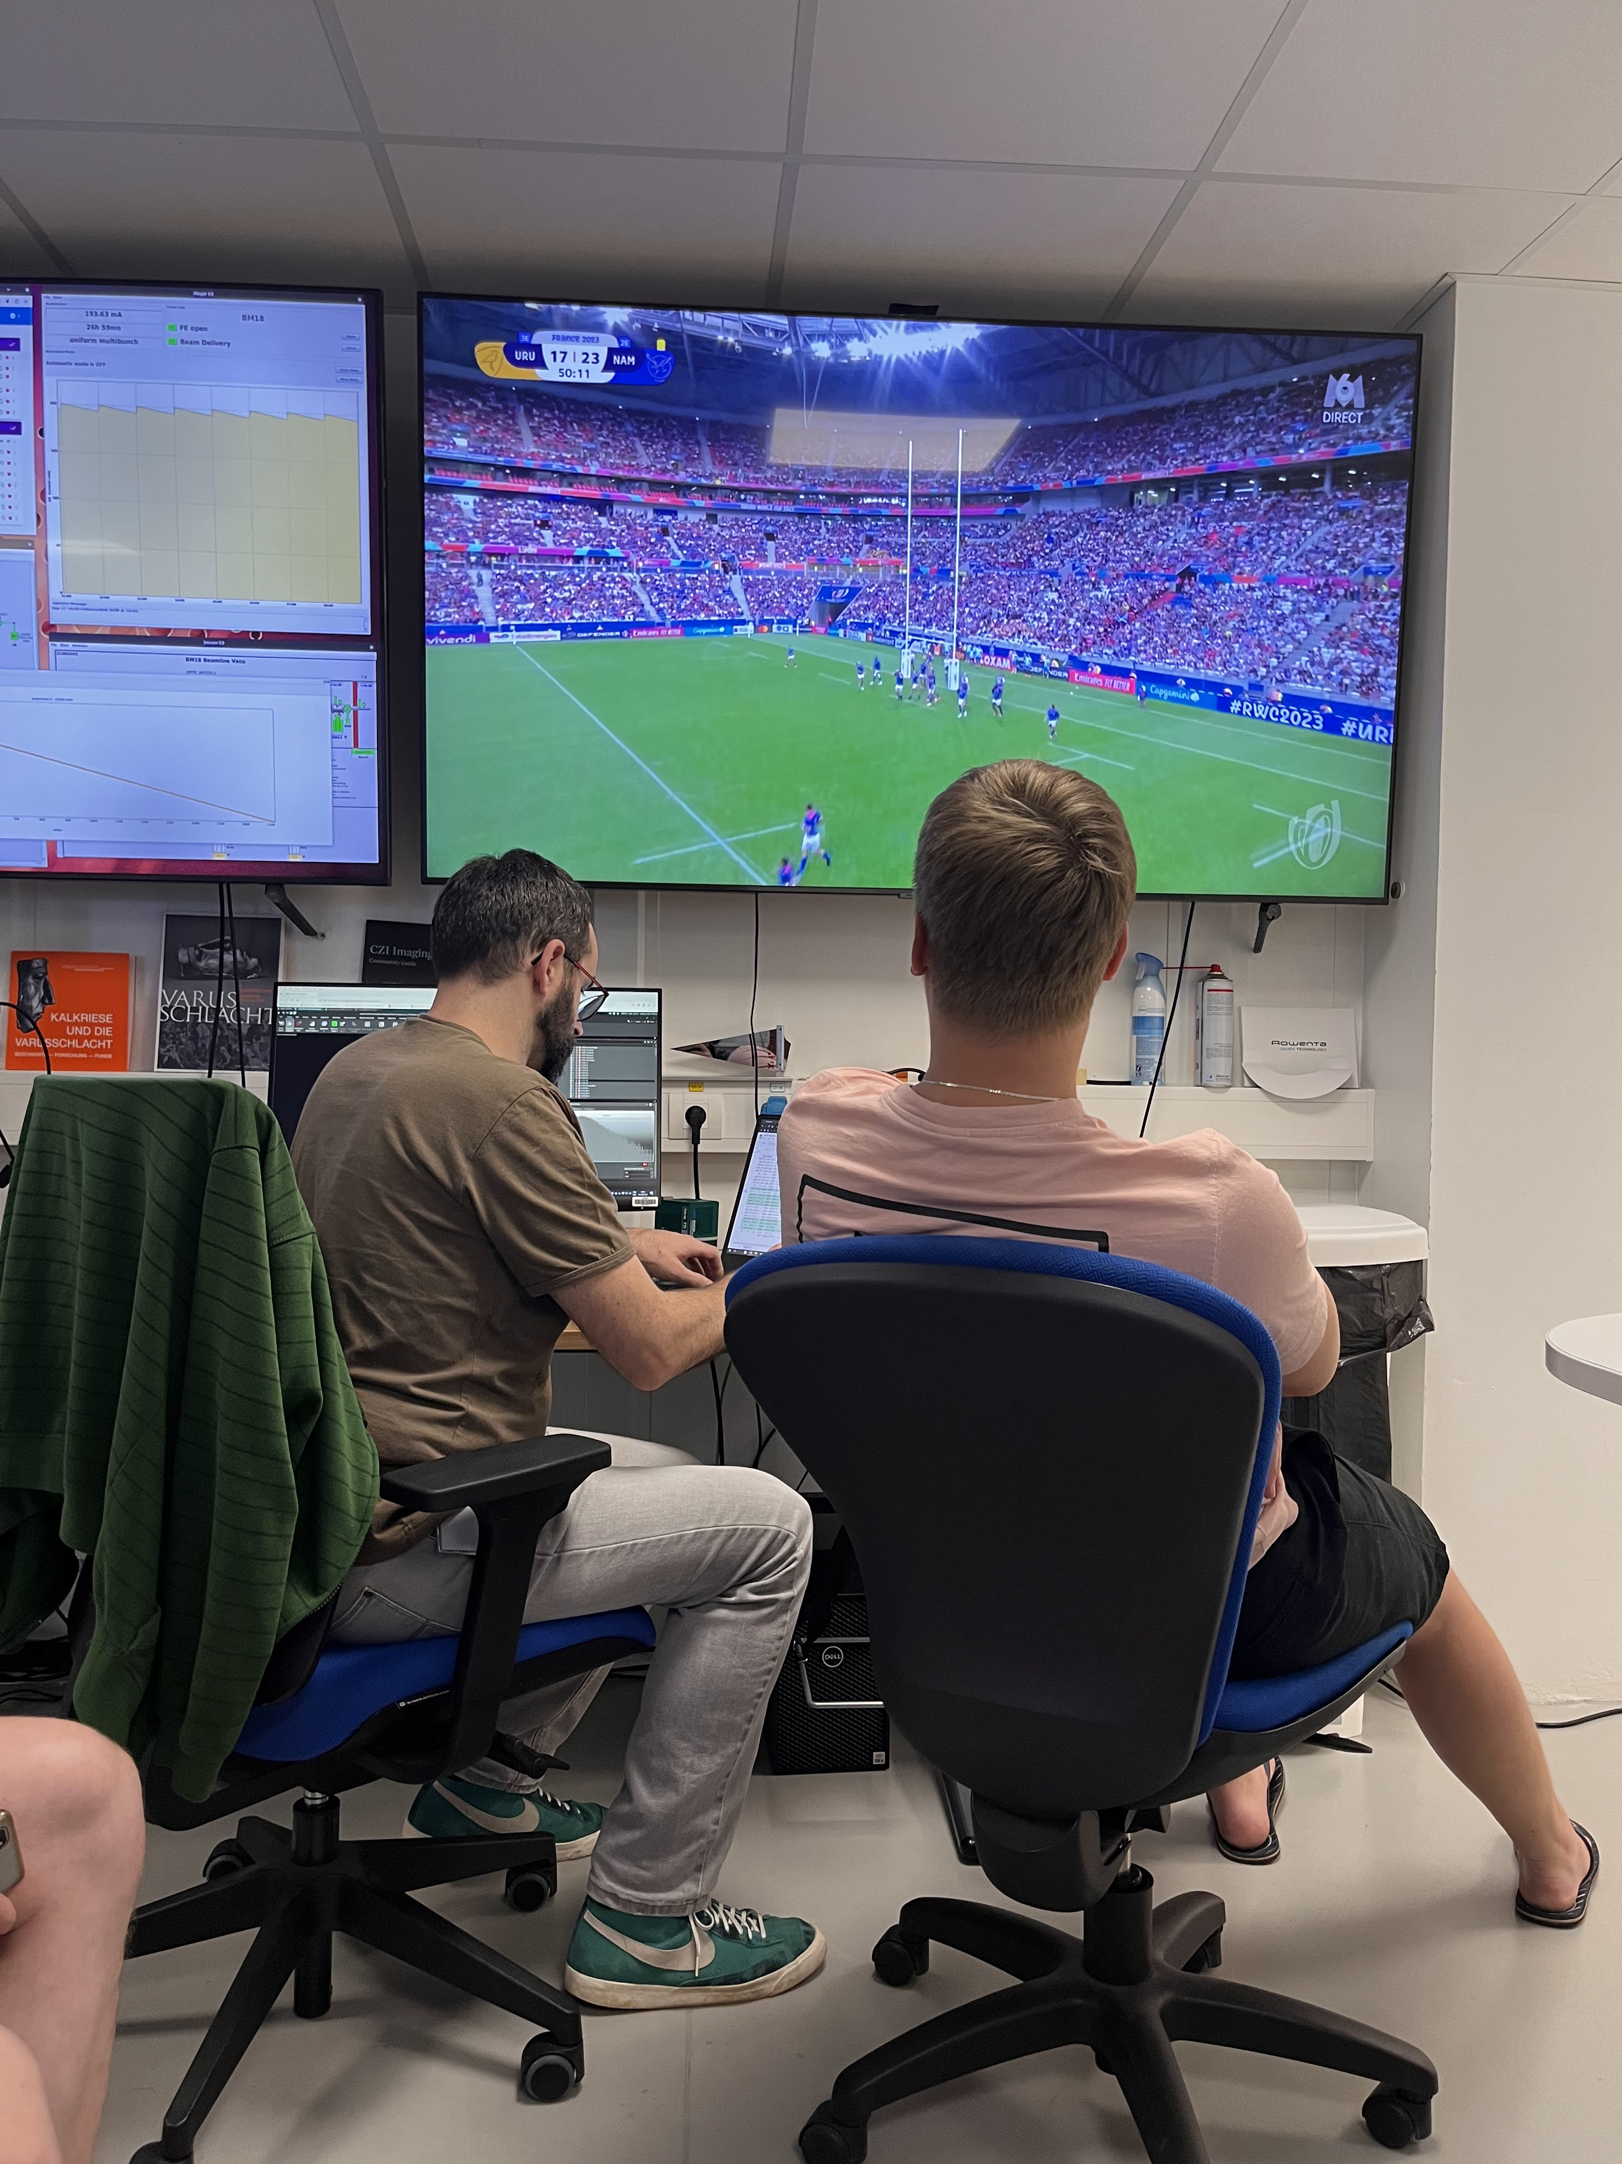
Results
Working hard at the ESRF!
Visual!!
Pictures
Graphs
Tables
Be creative in displaying your data

Slide 18
Tables
Prediction | Genus Staff | Students
Still awake | 90%? | 50%
Looking sleepy | 10% | 40%
Clearly sleeping | 0% | 10%
Wanting to go drink | 100% | 100%
% over time |  | 37%

Slide 19
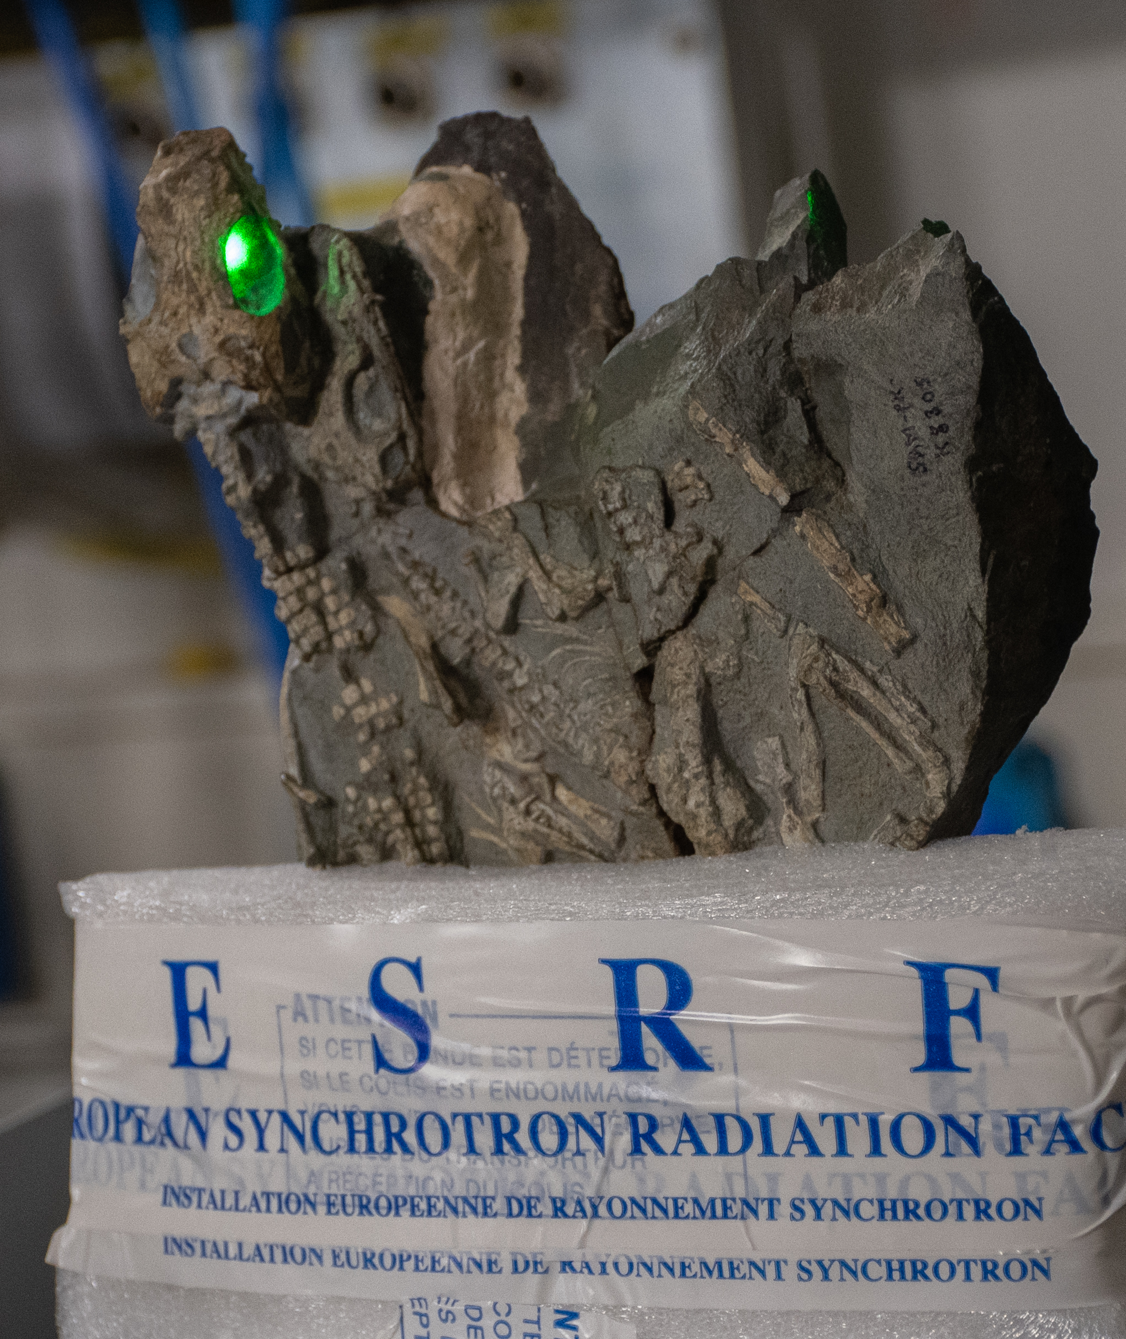
Discussion
Giving the evil eye
No boring list of points
Bullet points BUT with pictures
Add conclusions if you can
Add future work

Slide 20
Thank you
Acknowledge your funders!!

Slide 21
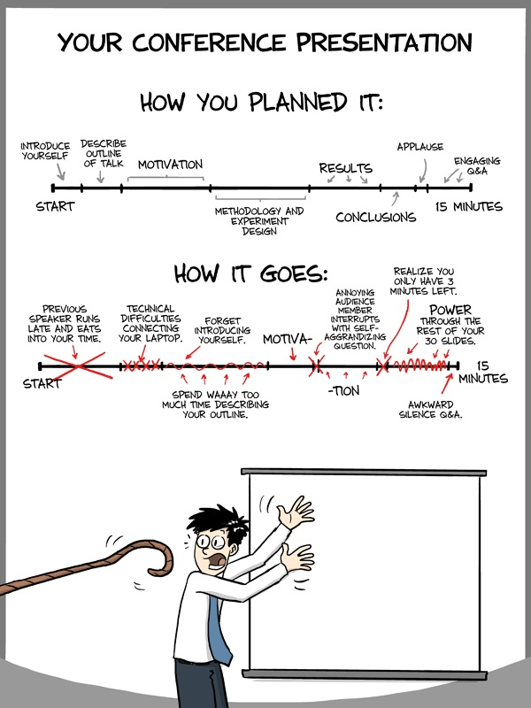
PRACTICE
TIME IT

Slide 22
What do you need?
How to’s:
How to write a CV
How to write a grant proposal for GENUS, PAST
How to write a grant proposal for the NRF
How to write a good scientific publication
How to write a popular article (social media)
How to write an application for a job

Slide 23
What do you need?
Help:
How to pick a project you will like
How to pick a good supervisor
How to communicate with your supervisor
How to find help when your supervisor is disinterested
How to write a thesis
Where to look for other sources of funding

